Slide 1

The North Texas Migration
Imran Kader

Slide 2

Objective
Dallas Fort Worth Metroplex (DFW) has seen influx of migration from East and West coast of United states. This is due to cost of living, availability and affordability of housing and job growth. My analysis will be targeting two major cities Plano and Richardson of North Texas. I will analyze their demographic, restaurant, crime and real estate so people migrating to North Texas can decide where they want to migrate to or open their business.

Slide 3
Data sets used
National Center for Education Statistics https://nces.ed.gov/
Crime report:
https://www.fbi.gov/services/cjis/ucr
Real Estate data https://www.zillow.com/research/data/
Restaurant data:
https://foursquare.com/

Slide 4
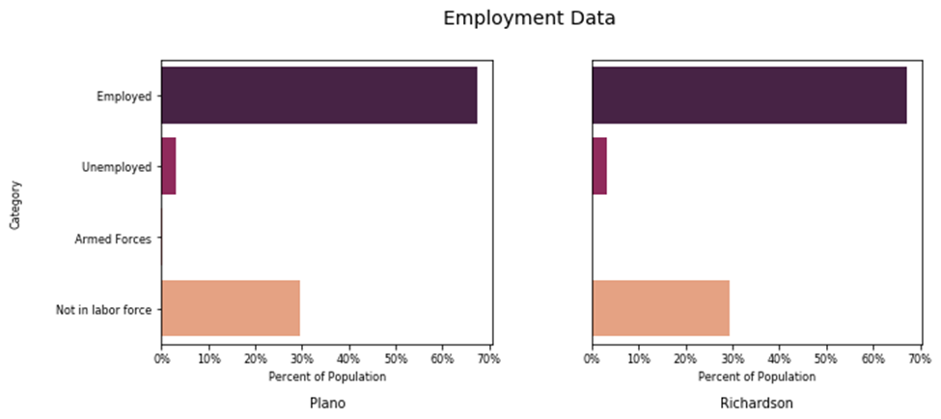
Employment Data

Slide 5
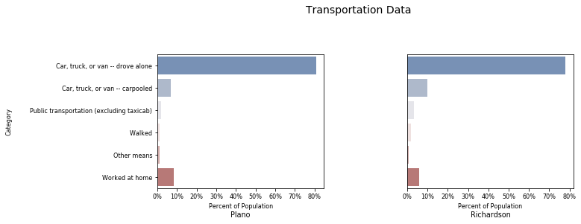
Transportation Data

Slide 6
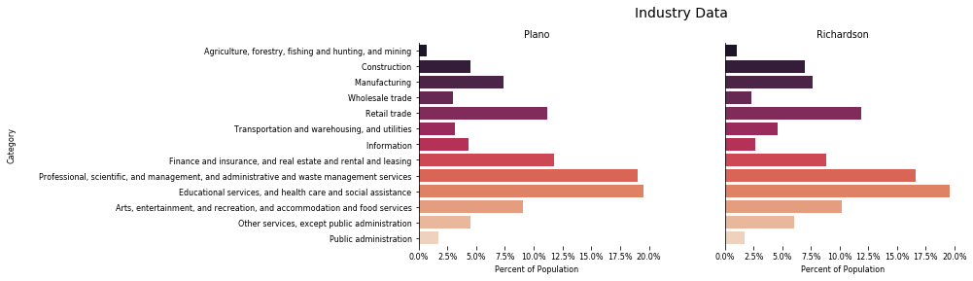
Industry Data

Slide 7
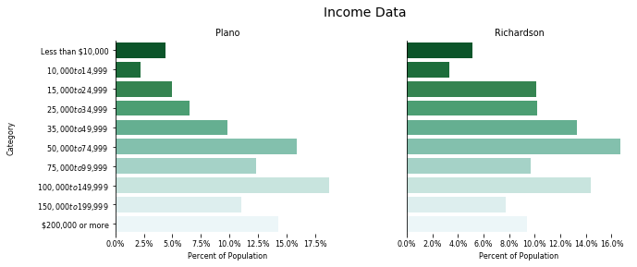
Income Data

Slide 8
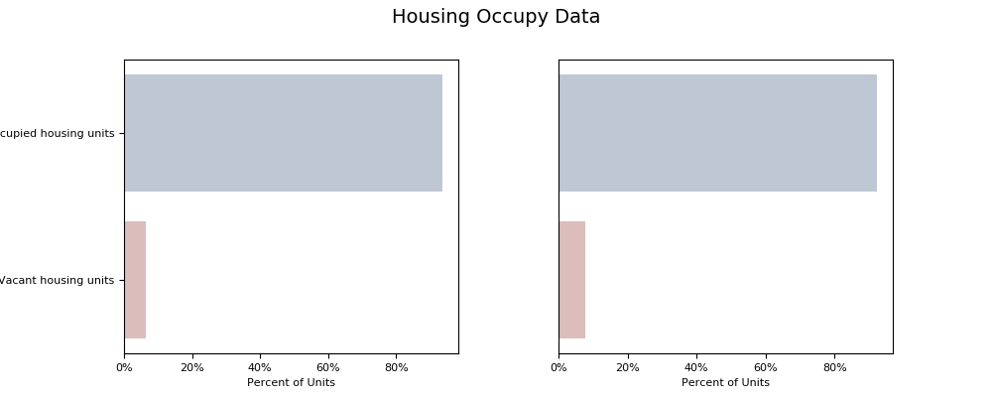
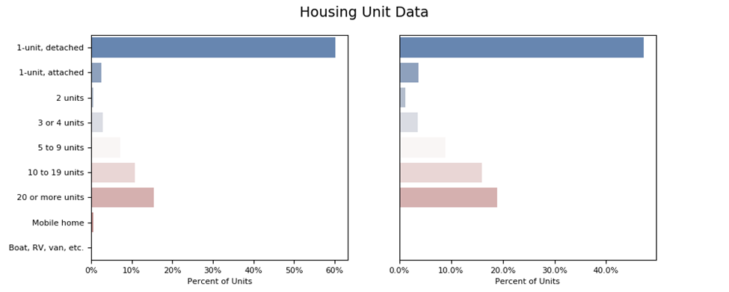
Housing Data
Plano housing units are one unit detached (single family home) and 25% are apartments (more than 10 units). Richardson has 47% single family homes and 35% apartments

Slide 9
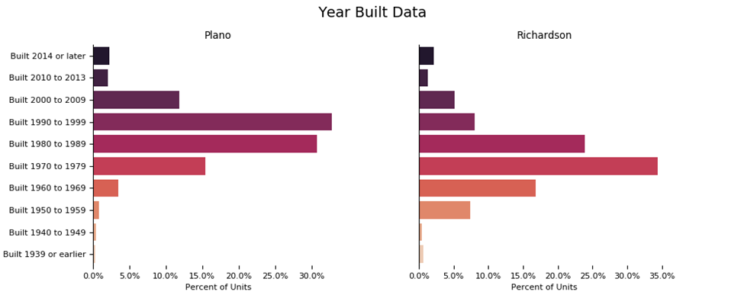
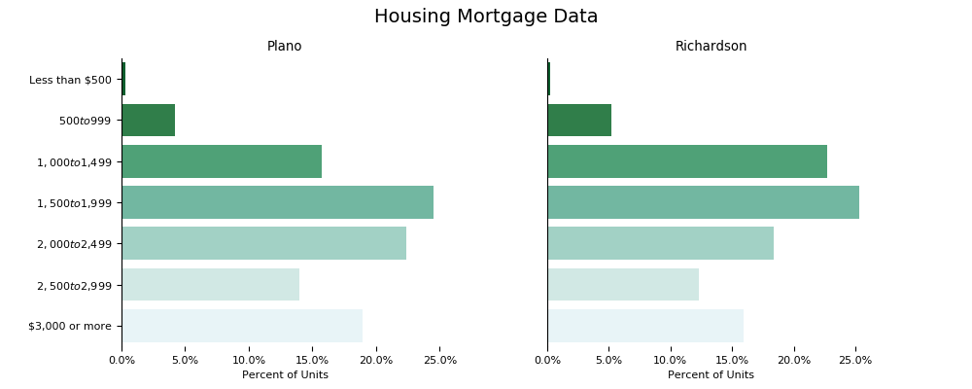
Year built and Mortgage Data
Richardson is an earlier suburb of Dallas Fort-Worth metroplex. It shows in the dataset Richardson housing units are 10-15 years older than Plano.

Slide 10
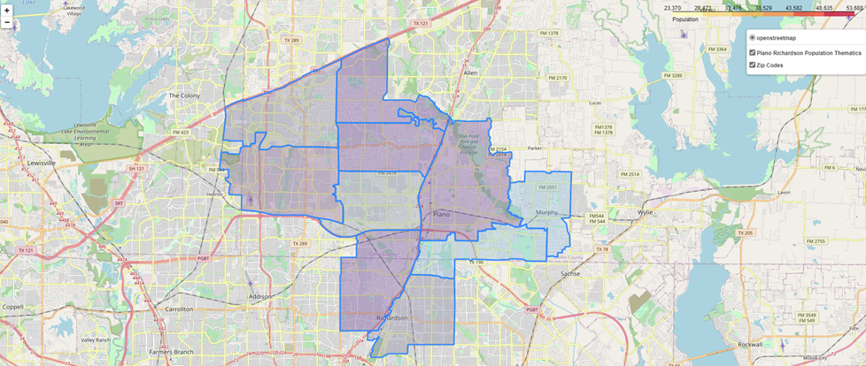
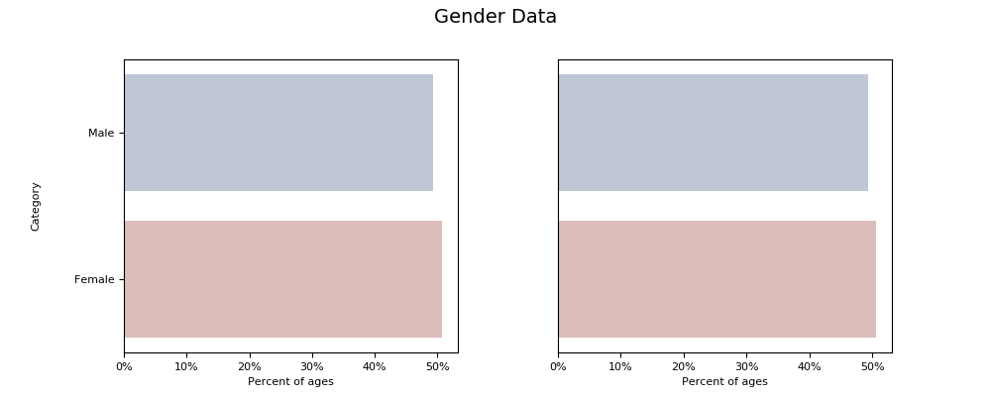
Population by Zip code & Gender Data
While Plano population is over 352k and Richardson is over 248k both cities have over 50% female

Slide 11
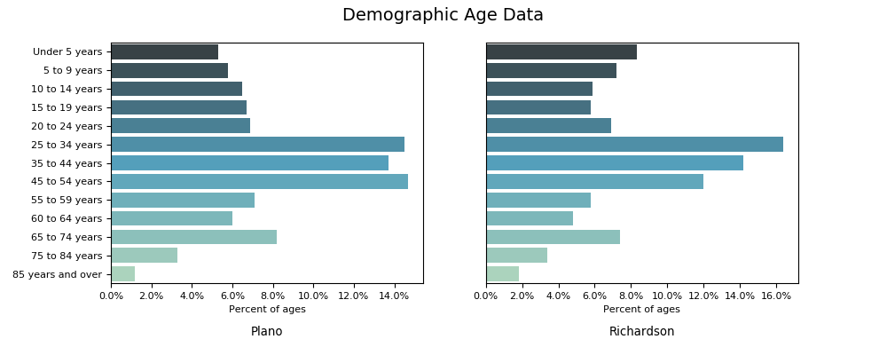
Age and Race Data
Plano has 65% white and Richardson has 54% as their corresponding highest percentage of population. Richardson has 50% less population of Asians while Plano has 50% less population of African Americans.

Slide 12
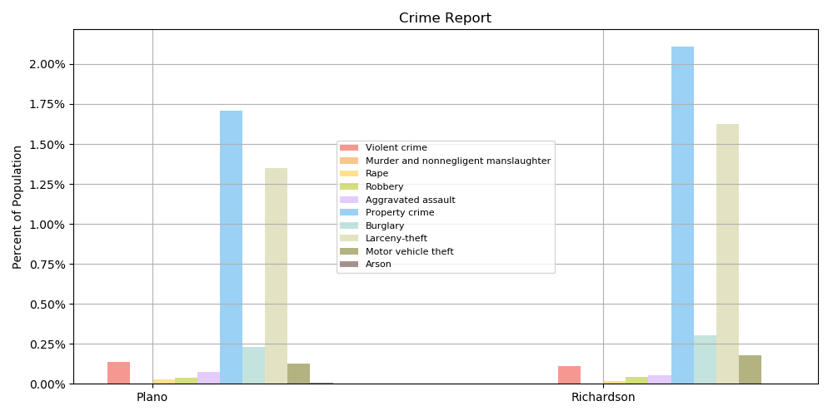
Crime Data

Slide 13
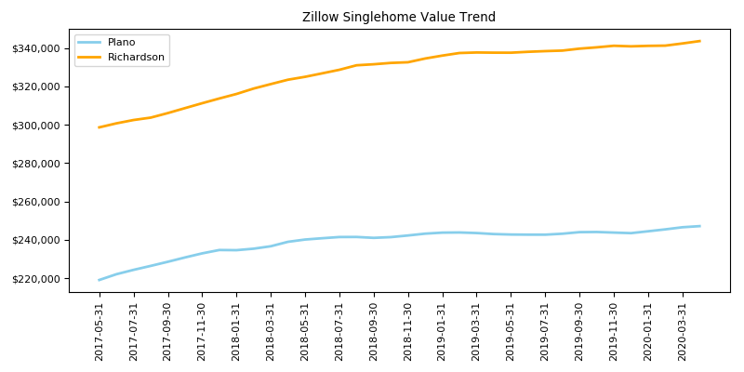
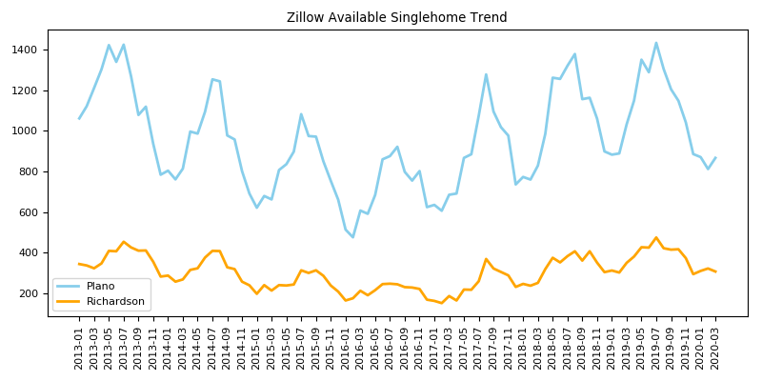
Zillow Real Estate data
Home value prices are trending upwards

Slide 14
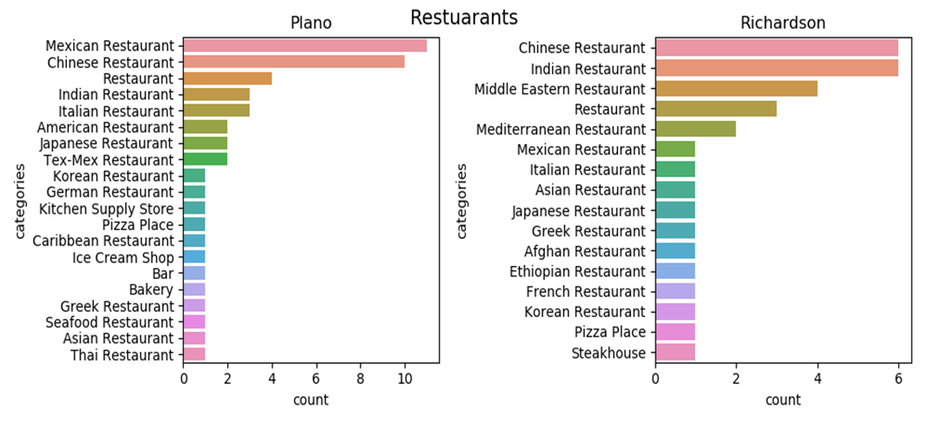
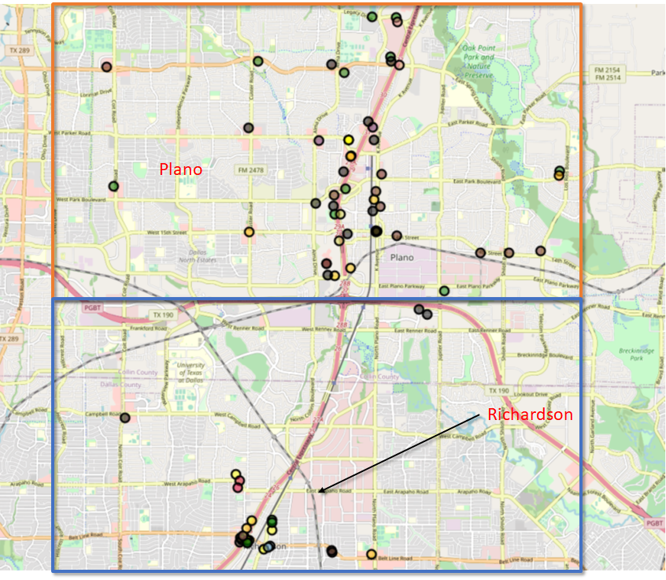
Four Square data
Chinese restaurant is high on both cities ranking 1 and 2 in Plano and Richardson.

Slide 15
Observation
While Richardson lacking Mexican restaurant when it Ranks as number 1 in Plano.
Plano does not show Middle Eastern/Mediterranean enough while it is high in count in Plano.
While Plano shows more spread out restaurants Richardson does not
Number of restaurants suggest population is Plano intend to eat out more than Richardson

